Slide 1
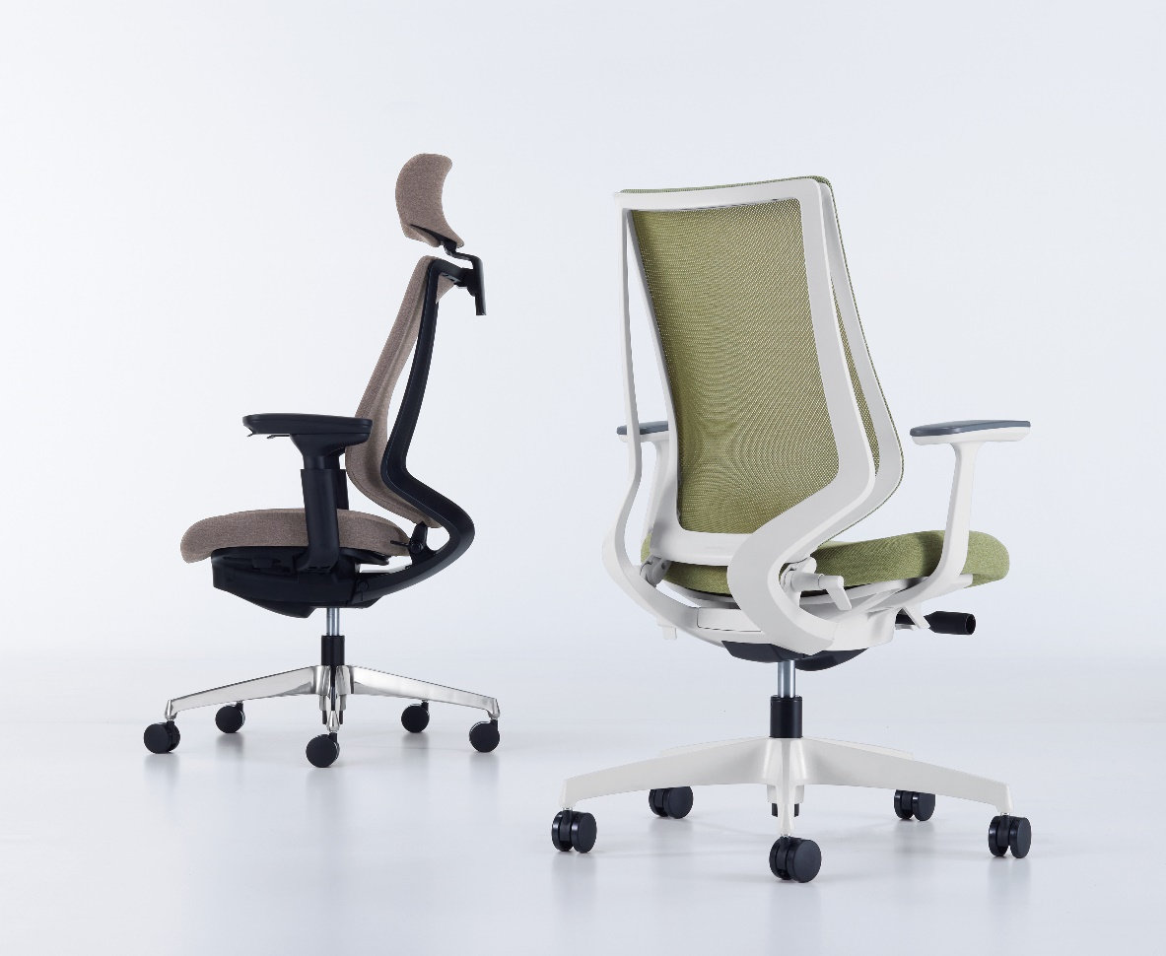

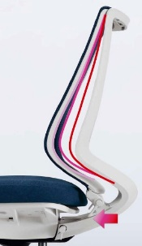
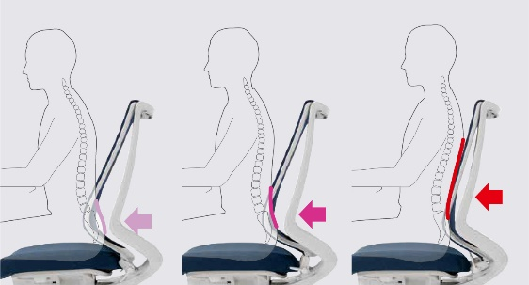
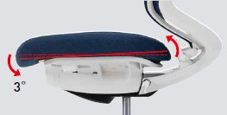
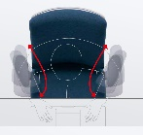
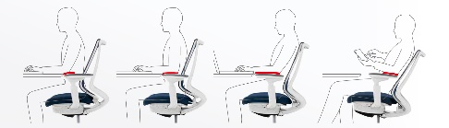
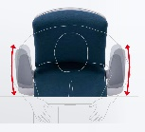
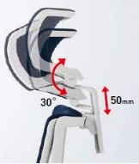


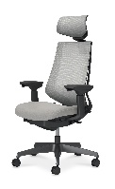
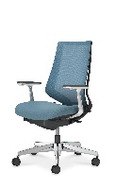
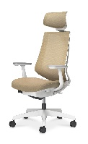
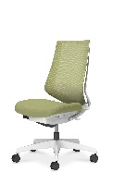
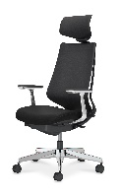
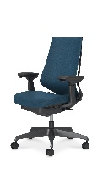
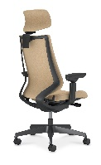
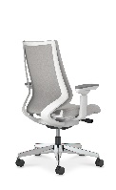









Duora２
Adjustable functions to cater postural changes and differences in body physique. Highly functional task chair ideal for variety of spatial settings.
Conforms to the following criteria’s as set in WELL v2.
・ V02 Part 3 (Provide Chair Adjustability)
・ X02 Part 2 (Manage Lead Paint Hazards)
Posture support functions to cater differences in work postures
3- stage pelvic adjust support
The lower back can be set inwards to one of 3-positions to provide support to the lower back and holding the pelvis in place to maintain adequate seating posture. Simple lever adjustment to the backward leaning/upright/forward leaning position.
Auto-tilt mechanism
The seat surface automatically adjusts to forward/backward leaning postures in accordance to the body movement. This maintains the spinal S-shape curvature even in the forward leaning posture. Further, the Auto-tilt enhances weight dispersion and relieves pressure on the under thighs.
Lower back: Outward position
Lower back: Middle position
Lower back: Inward position
2way motion armrest
Adjustable headrest
2way motion armrest with a wide adjustment range to suit different seating posture from forward leaning /upright / backward leaning postures. Sliding motion to cater difference in body physique and improved operability to be used in the optimal position.
Height and angle adjustable headrest to suit different body physique and working postures. Support to the back of the head to reduce pressure strain on the back and neck.
Height range:
50mm / 6-stages
Angle range: 30°
(Smaller physique) Inward range
Writing・PC work
Forward leaning
Multi-work
Upright posture
Solo work
Backward leaning
Browsing
Relaxed posture
(Larger physique) Outward range
Selection
Color Codes
Mesh back
Plastic base (Black)
Headrest
Adjustable arms
Polished base
High back
Aluminum arms
Plastic base (White)
Headrest
Fixed T-arms
Plastic base (White)
High back
No arms
Fabric backrest
Polished base
Headrest
Aluminum arms
Plastic base (Black)
High back
Adjustable arms
Plastic base (Black)
Headrest
Adjustable arms
Plastic base (White)
High back
Adjustable arms
Body
E1
White gray
BK
Black
\148,700～
\130,700～
\138,700～
\97,500～
\155,600～
\120,800～
\145,700～
\126,500～
Seat
(Fabric)
KAE6
Black
KAE3
Soft gray
KAM6
Dark greige
KA1K
Soft beige
KAQ6
Deep green
KAV3
Grass green
KAT7
Navy
KAR3
Monti cola blue
KAAG
Persian red
KA0T
Soft terracotta
※ Prices shown are List prices (Excluding TAX)

